Slide 1


Department of Electronics and Communication Engineering
Data Transmission through Ultrasonic Sound
By:
Shreyas R PES1201701714
Praphul Gowda PES1201700237
Karthik K Bhat PES1201701499
Guide:
Dr. Anuradha M
Mrs. Savithri K R
Ms. Shilpa Hosur

Slide 2
Abstract
Short-range connectivity among electronic devices is essential to build a connected world.
With billions of connected devices, the need for devices to identify and communicate with each other is increasing.
Radio Frequency based wireless communication rely on high power radio transmitters

Slide 3
Introduction
Data can be transmitted with standard speakers and microphones.
Ultrasonic bypasses the physical limitation of short-range RF.
Similar to other communication protocols, data can be encrypted and transmitted.
Properties of sound enable quick localised data transfers which is key factor in sharing resources based on proximity.

Slide 4
Problem Statement
Design a prototype that is able to transfer digital data using ultrasonic sound
# | Details | Value | Unit | Remark
1 | Transmission Length | 20 | centimetre | Maximum length
2 | Transmitter Power | TBD | Watt
3 | Power Supply | 5 | Volts
4 | Transmission Speed | 80 | bps
5
6

Slide 5
Literature Survey
The 18.5 to-20 kHz is inaudible to most humans and yet realizable with commodity speakers and microphones in mobile devices.
Modulation is made in such a way that makes it robust to noise and reverberation in the environment.
Speakers of common phone produces 74 dB SPL at 18 kHz whereas the threshold is 86 dB SPL to be audible.
The range is reliable for a maximum distance ranging from 2 m to 10 m.

Slide 6
Applications
Ultrasonic data transmission can be used under-water.
Short-range resource sharing between devices.
Data transmission in places where electromagnetic radiations are harmful e.g. Petrol bunks, Healthcare

Slide 7
Approach
Microcontroller
Ultrasonic Transmitter
Ultrasonic Receiver
Microcontroller
Data to be sent
Data received

Slide 8
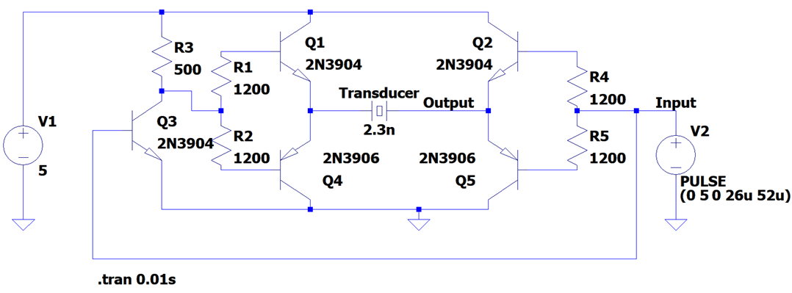
Transmitter Schematic
Notes:
>> Uses PNP and NPN transistors to bring the current levels to an optimum range which is suitable for the ultrasonic transducers to operate.
>> The current levels varies with respect to the message signal.

Slide 9
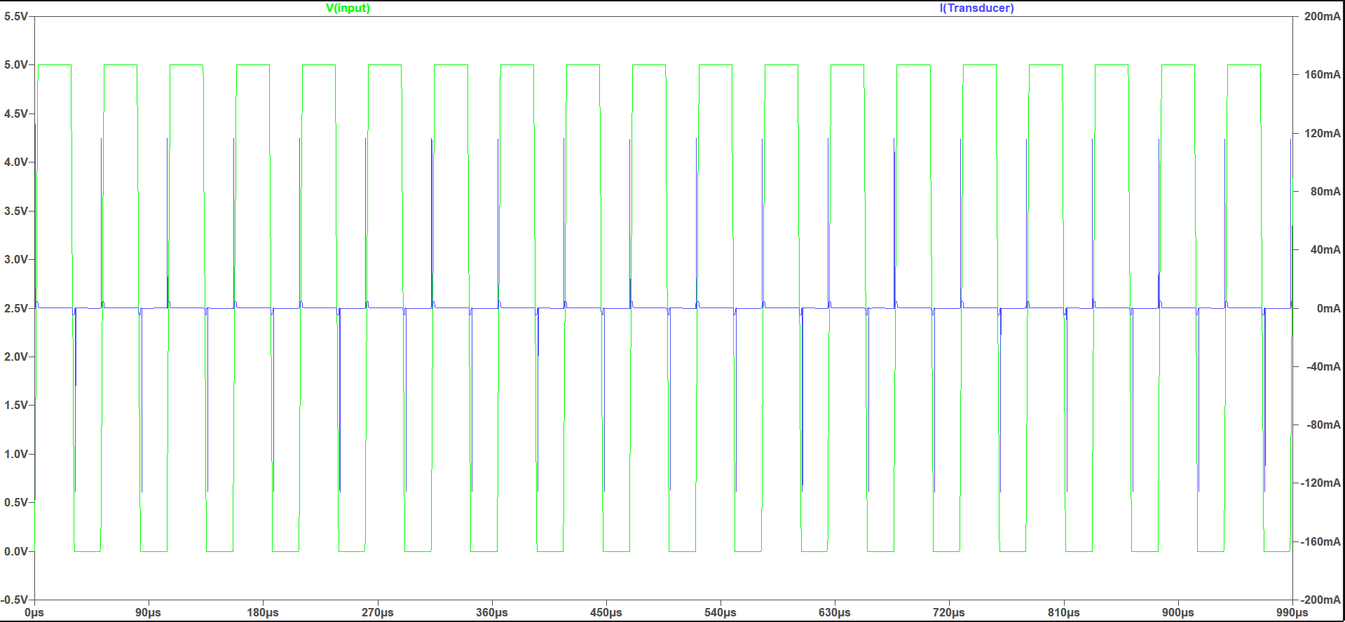
Transmitter Circuit Simulation
Simulation of Ultrasonic Transducer Driver Circuit on LTSpice software

Slide 10
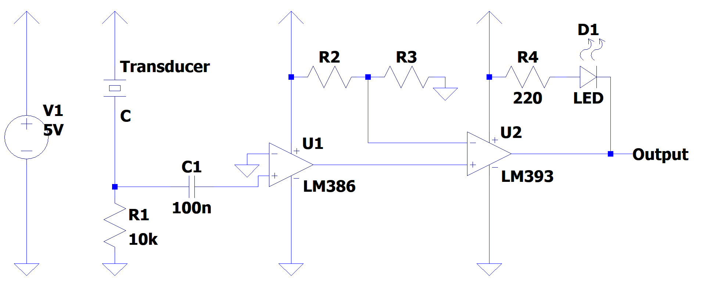
Receiver Schematic

Slide 11
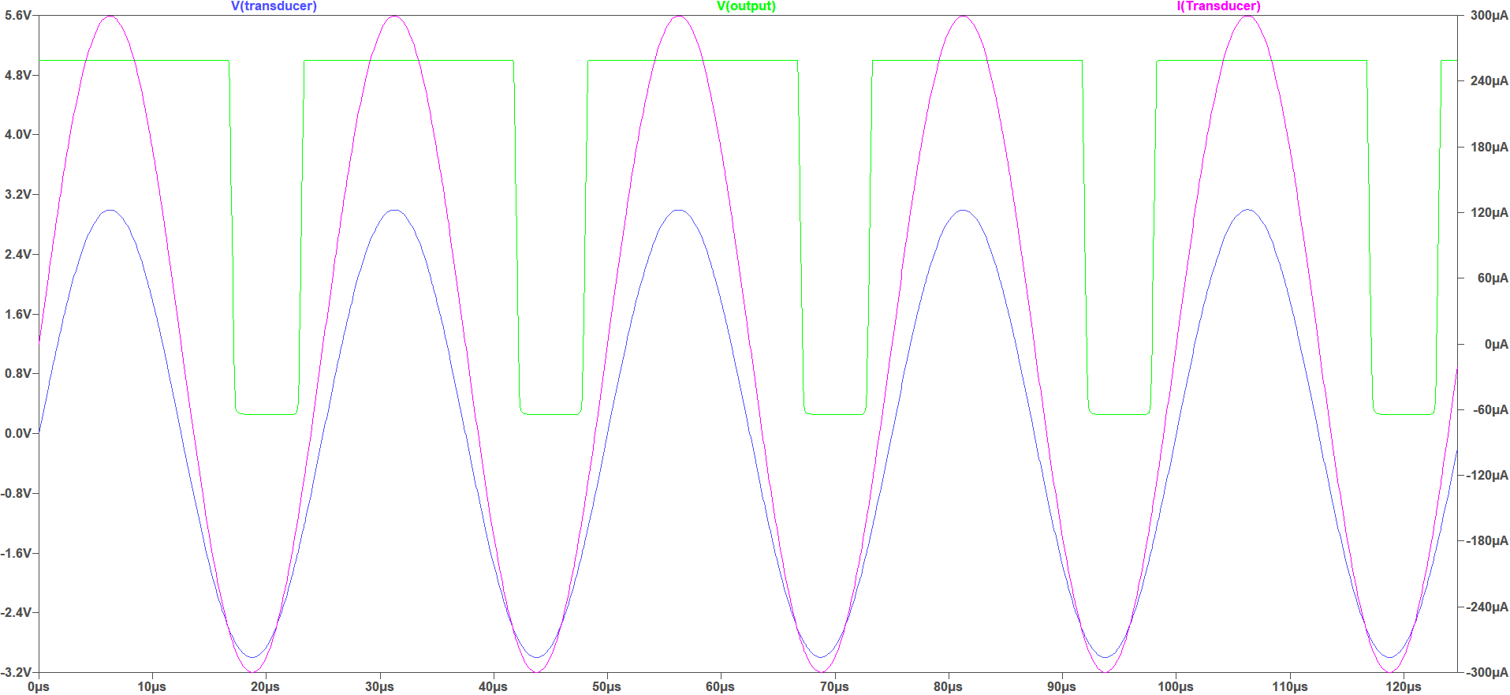
Receiver Circuit Simulation
Simulation of Receiver Circuit on LTSpice software
Simulation of Receiver Circuit on LTSpice software

Slide 12
Transmission Algorithm
A square wave of 40 kHz is used for transmission.
Denote the start of the transmission of a byte by sending the square wave for a duration of 10 milli-seconds.
Read individual bits of the data.
If the bit is 1, then send the square wave for 2 milli-seconds.
If the bit is 0, then send the square wave for 4 milli-seconds.
Wait for 10 milli-seconds before transmitting the next bit.
Notes:
Tone() - Generates a square wave of the specified frequency on specified pin with 50% duty cycle

Slide 13
Reception Algorithm
Find the maximum time of reception and minimum time of reception.
The minimum time of reception refers a high bit.
Twice the minimum time of reception refers a low bit.
Half the maximum time of reception refers to reception of next bit
The maximum time of reception refers to reception of a new byte.
Have some threshold for the reception time to accommodate small variation in the length of transmission.
Encode the time in terms of bits and read the characters.

Slide 14
Developed Hardware

Slide 15
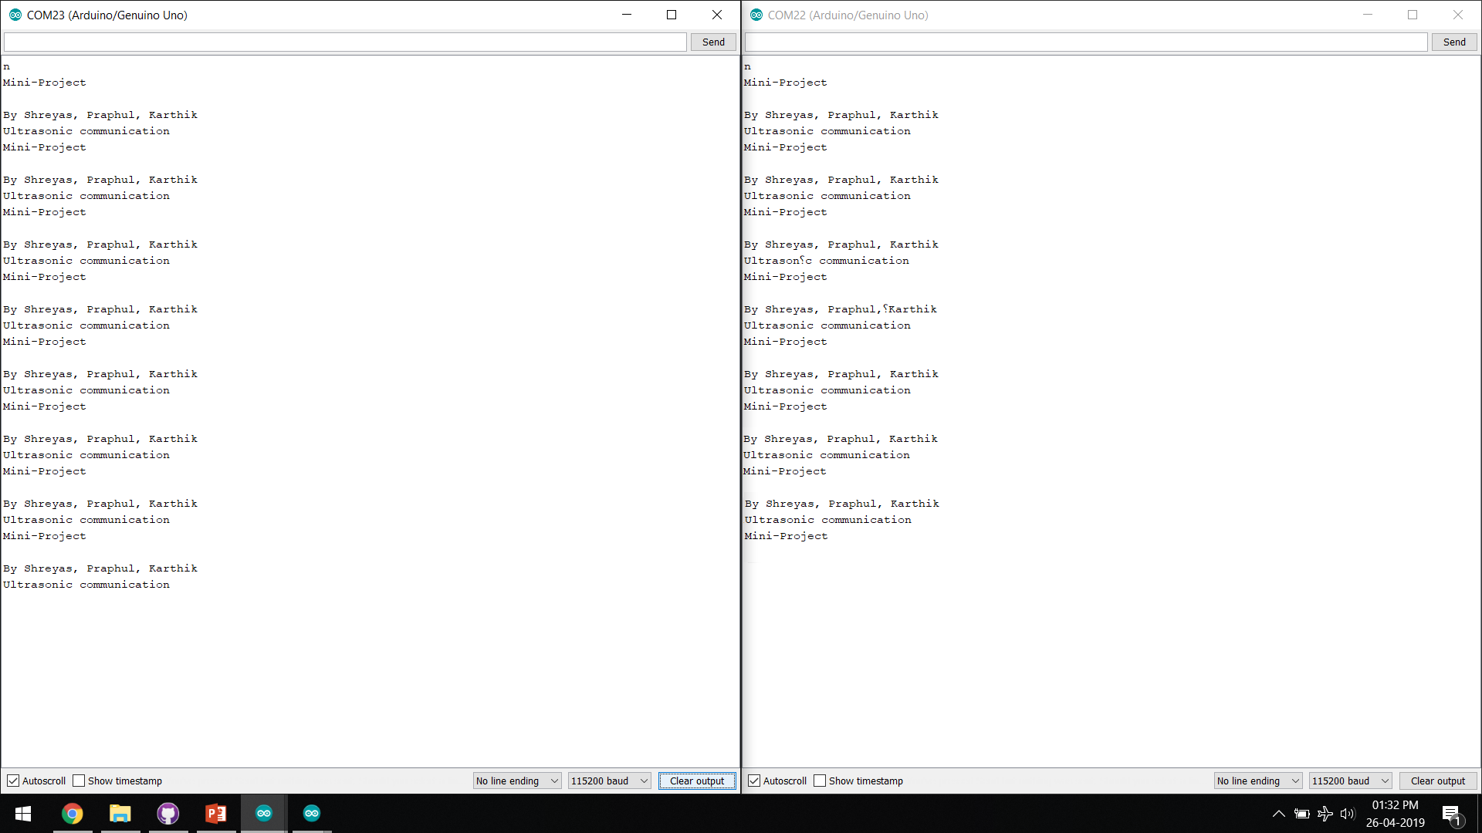
Results
Simulation of Receiver Circuit on LTSpice software
Simulation of Receiver Circuit on LTSpice software

Slide 16
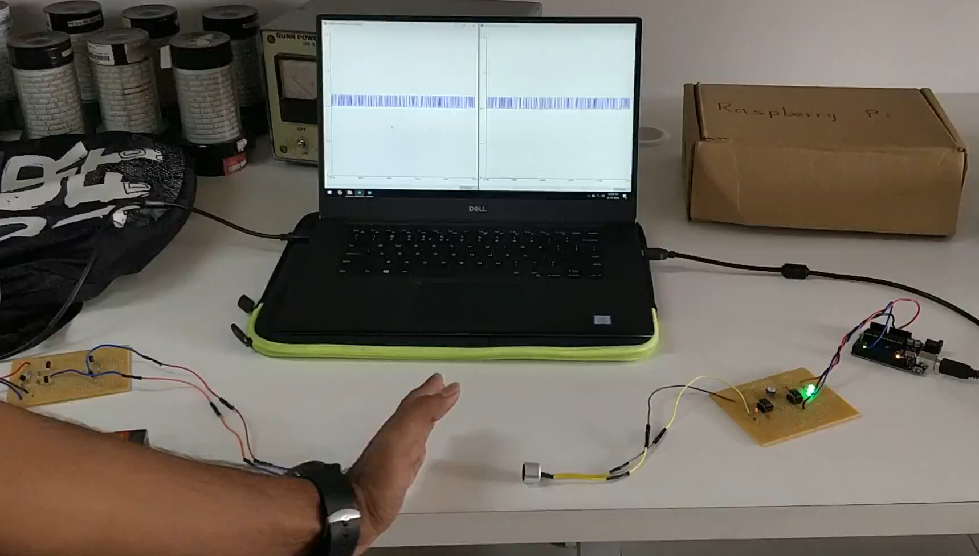
Demo Video

Slide 17
Future Scope
To improve the prototype for dynamic length of transmission
Find better, efficient algorithm to increase the speed of transmission
Interface with smartphones
To help in transfer of data in electromagnetic sensitive zones.
To help in pairing of devices

Slide 18
Conclusion
Successfully transmitted data using Ultrasonic sound.
Our prototype works only when transmitter and receiver transducers are in line-of-sight.

Slide 19
Progress Timeline
Week 1
Literature Survey
Week 2
Understand working of Transducer and HC-SR04
Week 3
Design and simulation of Transmitter circuit #1
Week 4
Week 5
Design and simulation of Transmitter circuit #2
Design and simulation of multiple receiver circuit
Week 6
Building and testing the transmitter circuit

Slide 20
Progress Timeline
Week 7
Building and testing the receiver circuit
Week 8
Developing the algorithm and code for transmission
Week 9
Developing the algorithm and code for reception
Week 10
Week 11
Testing the hardware
Verifying the outputs
Week 12 & 13
Changes to hardware
Compiling the results
Attempt to find algorithm for dynamic length of transmission

Slide 21
Literature
https://lisnr.com/resources/blog/ultrasonic-data-transmission-compares-rf/
https://ieeexplore.ieee.org/document/8080245
http://www.kerrywong.com/2011/01/22/a-sensitive-diy-ultrasonic-range-sensor/
http://www.pcserviceselectronics.co.uk/arduino/Ultrasonic/electronics.php

Slide 22
References
kHz | Kilo Hertz
bps | bits per second
RF | Radio Frequency
dB | Decibels
dB SPL | Sound Pressure Level (1 Pascal is equal to SPL of 94 dB)
m | meter
SNR | Signal to Noise Ratio
GND | Ground

Slide 23
Thank You

Slide 24
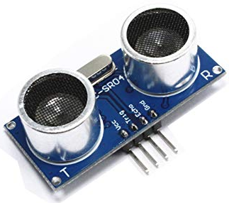
HC-SR04
HC-SR04 is an ultrasonic distance sensor.
It has two transducers – one acting as a transmitter and the other as receiver.
It has four pins:
VCC – Positive terminal of the power source.
Trig – Trigger pin to send burst of ultrasonic.
Echo –Echo pin to receive the reflected ultrasonic sound.
GND – Negative terminal of power source

Slide 25
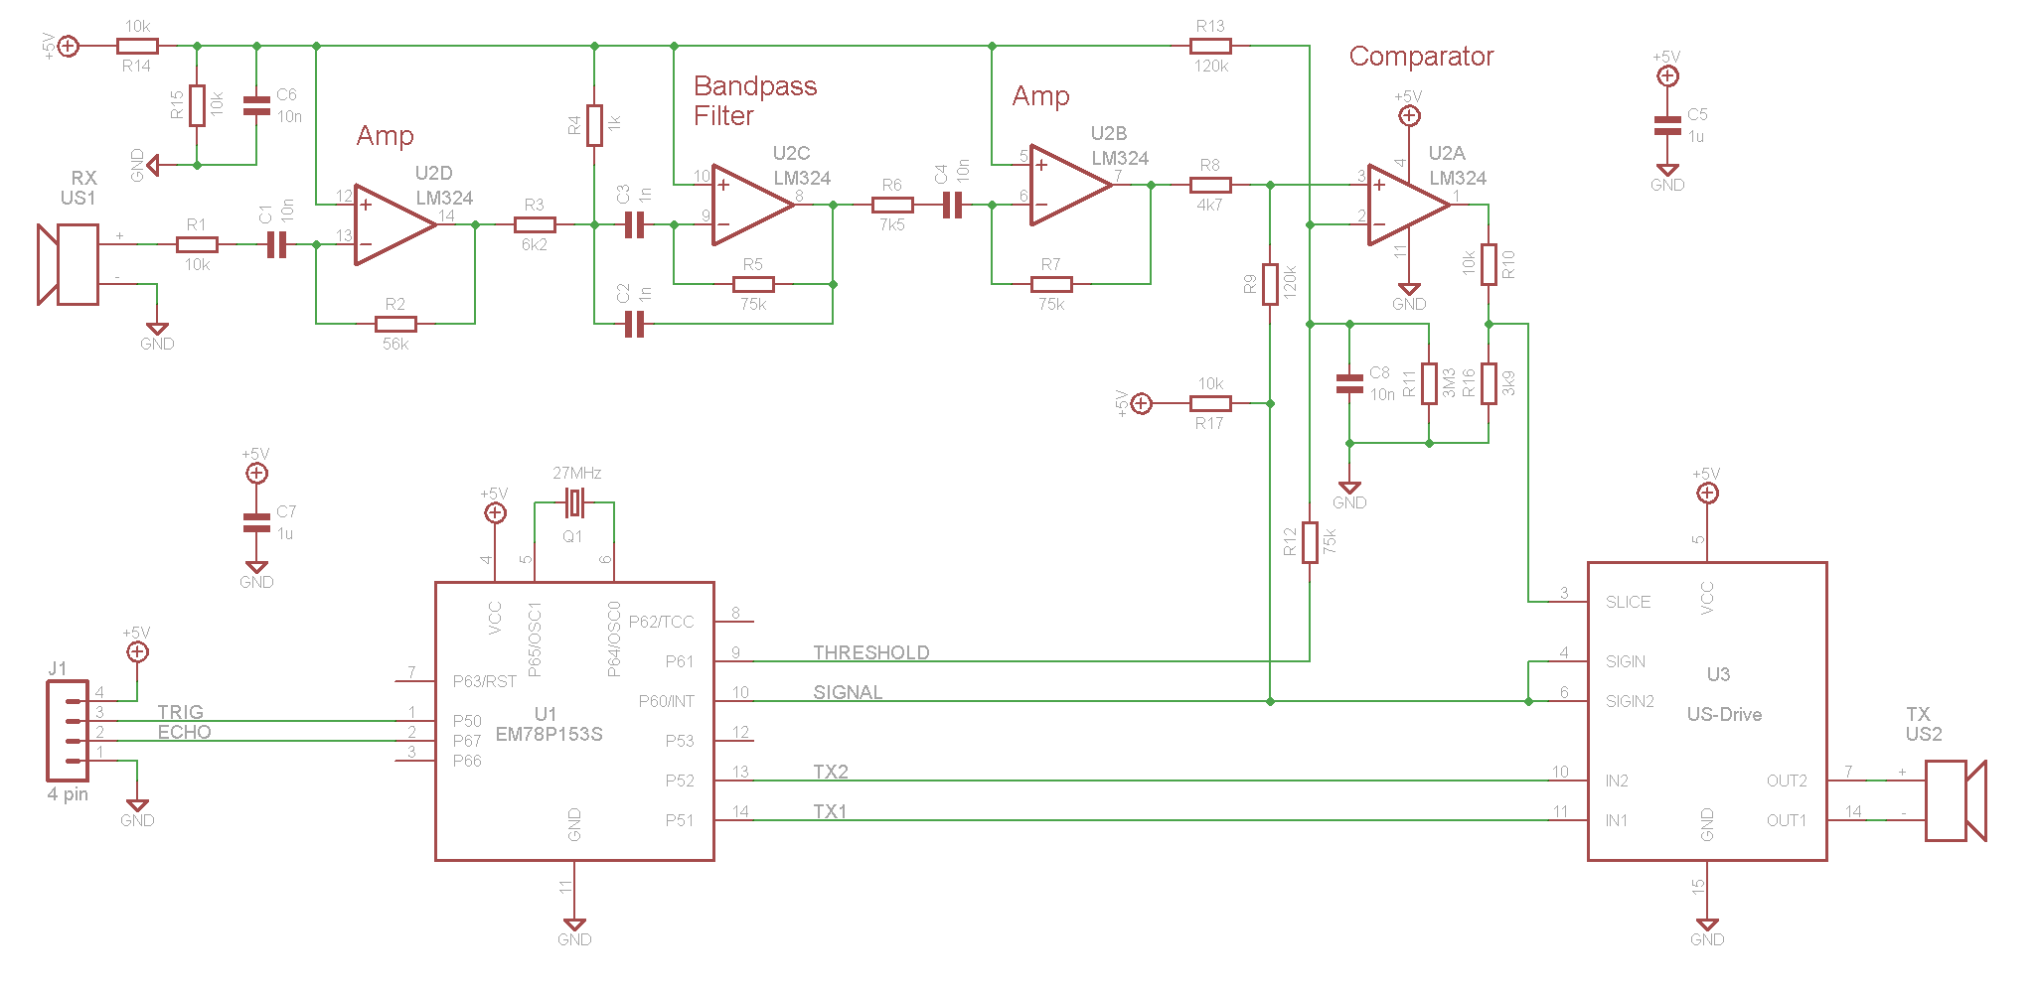
HC-SR04 Circuit
HC-SR04 Ultrasonic sensor circuit

Slide 26
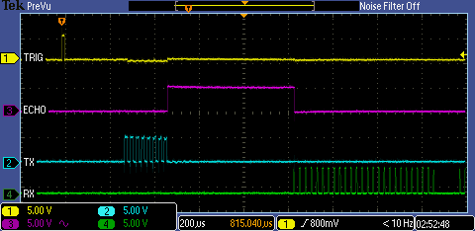
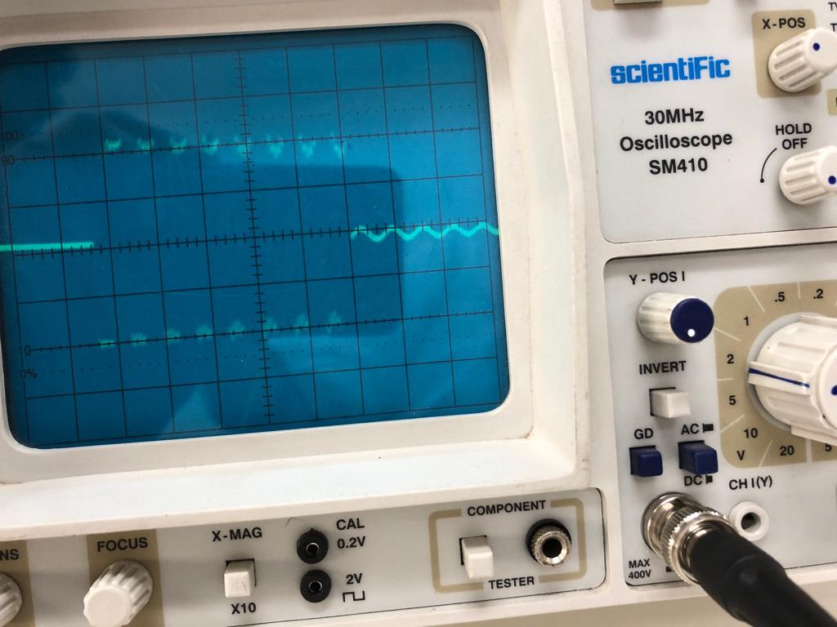
Working of HC-SR04
Trigger pin is given a pulse.
A burst of 8 pulses of 40 kHz is sent via transducer.
The echo pin is set high.
Once reflected wave is detected, the echo pin is set low.
Scope shot of signal timing
(Source: pcserviceselectronics.co.uk)
Scope shot at Tx
(Taken at lab)

Slide 27
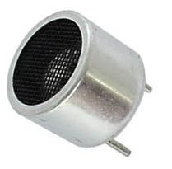
Transducers
The transducer is a device that converts electrical signal to physical quantity or vice versa.
The main criteria to choose a ultrasonic transducer are the resonant frequency, radiation pattern and sensitivity.
Sensitivity affects the efficiency of the transducer and also attributes to the SNR.
For the receiver and transmitter, we would be using 40 kHz ultrasonic transducer.
Notes:
>> With properly designed circuits these sensors can easily achieve a range of more than 20 feet.
>> The power rating of the transducer is quite low when compared with other transducers and the optimum operating voltage is around 6 volts.

Slide 28
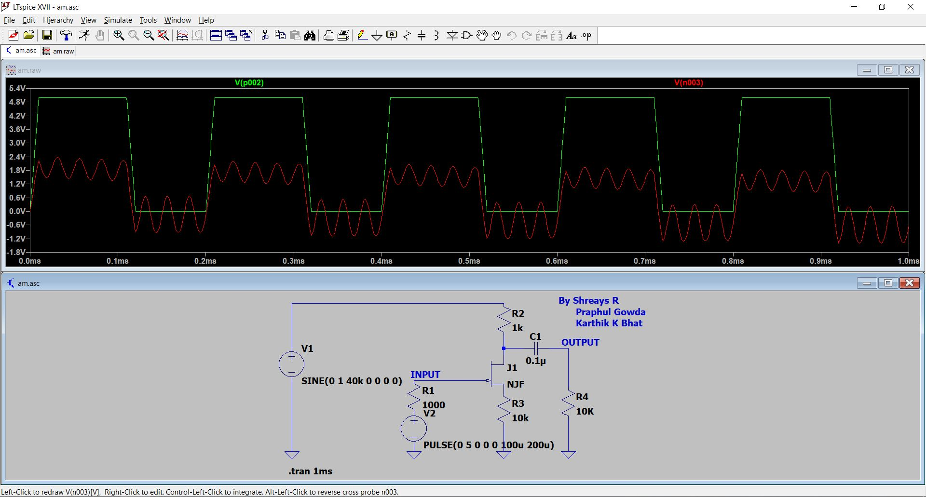
Transmitter Circuit #1 Simulation
Simulation of Amplitude Modulation Circuit using JFET on LTSpice software

